Slide 1
Spring IoC

Slide 2
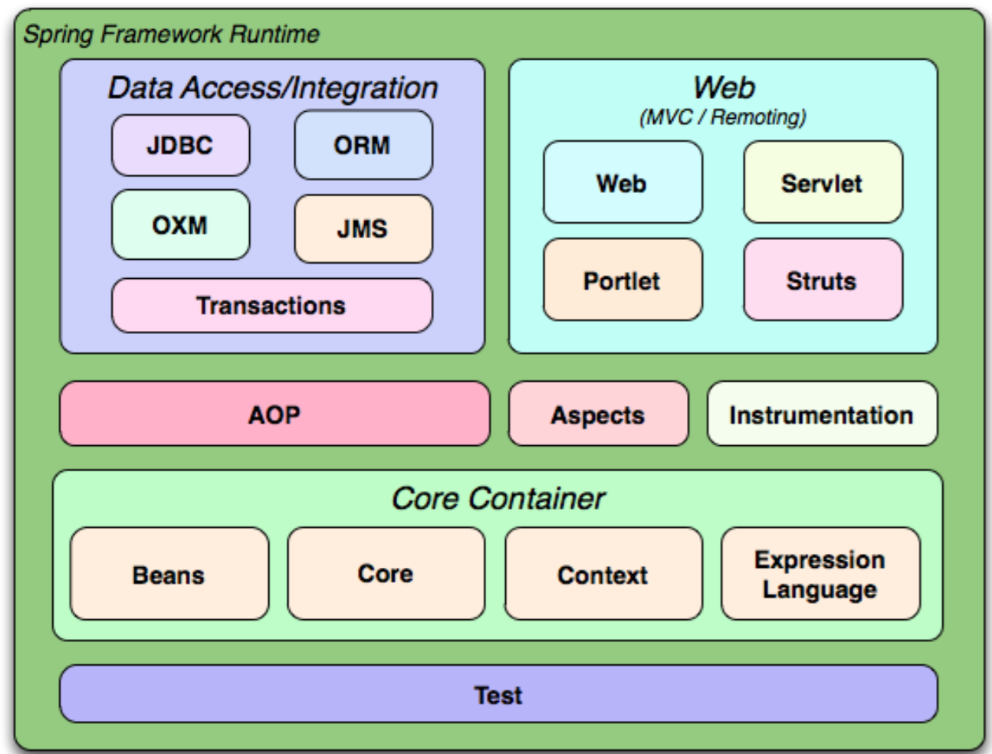
Spring
Spring 4
Spring 5 will be production ready next year (reactive)

Slide 3
Spring Modules
Spring modules http://docs.spring.io/spring/docs/current/spring-framework-reference/html/overview.html#dependency-management
No big blob .jar file for all spring core+modules
Separate dependencies - spring-*.jar
spring-core-**.RELEASE.jar
spring-context-**.RELEASE.jar
spring-webmvc-**.RELEASE.jar
spring-aop-**.RELEASE.jar

Slide 4
Agenda
15 practical examples
Dependency Injection and Spring Containers
Bean Definitions
Bean Configuration
Custom Factory for your beans
Autowiring when multiple candidates found
Bean Scope
Bean lifecycle hooks
Property values in Spring
Profiles
Low coupling with application events

Slide 5
Gradle
repositories {
mavenCentral()
// and optionally...
maven { url "http://repo.spring.io/release" }
}
dependencies {
compile("org.springframework:spring-context:4.3.4.RELEASE")
testCompile("org.springframework:spring-test:4.3.4.RELEASE")
}

Slide 6
Dependency Injection

Slide 7
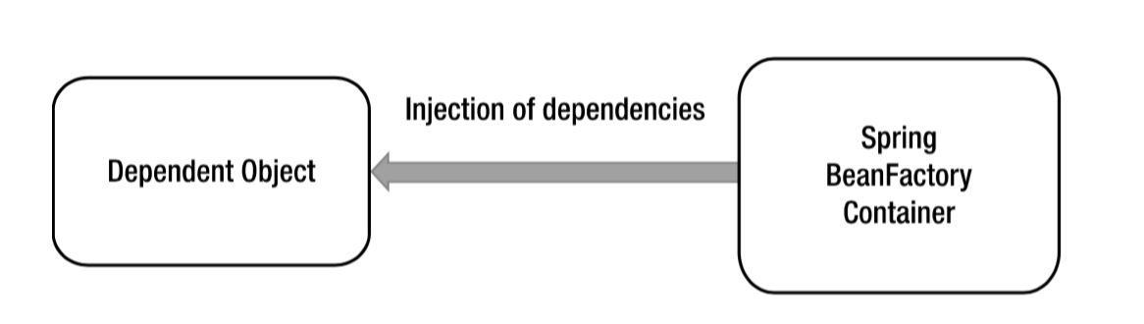
Inversion of Control in Spring

Slide 8
IoC Containers in Spring
Spring comes with two types of containers
BeanFactory
ApplicationContext

Slide 9
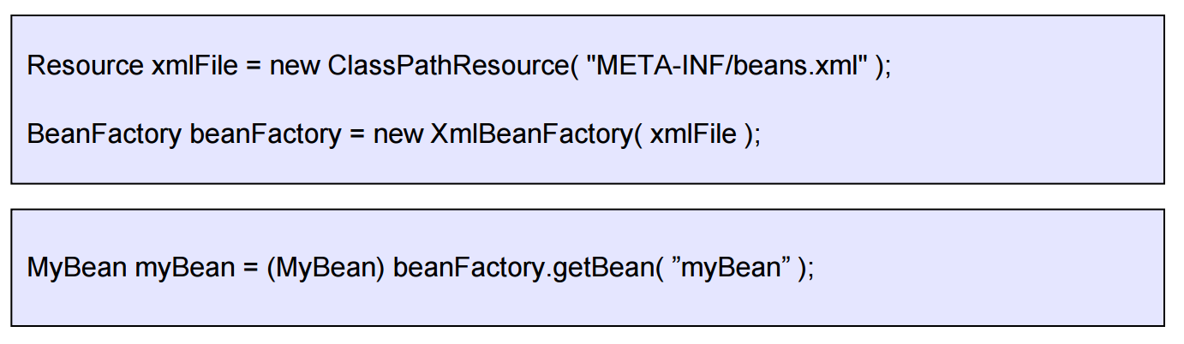
The BeanFactory
Provides basic support for dependency injection
Responsible for
Creating and dispensing beans
Managing dependencies between beans
Lightweight – useful when resources are scarce (Mobile applications)

Slide 10
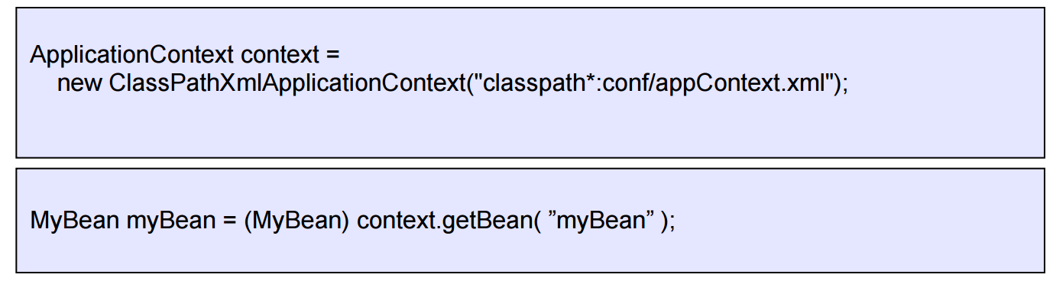
The ApplicationContext
Built on top of the BeanFactory
Provides more enterprise-centric functionality
Internationalization, AOP, transaction management
Preferred over the BeanFactory in most situations.
Use ApplicationContext, unless you are integrating with low-level frameworks

Slide 11
Hierarchy of Application Contexts
There can be hierarchy of ApplicationContexts
web-application
Camel+Spring

Slide 12
Run Spring application
Annotation based configuration
ApplicationContext ctx = new AnnotationConfigApplicationContext
(MainAnnotatedClass.class);
XML-based configuration
ApplicationContext ctx = new ClassPathXmlApplicationContext
("META-INF/spring/app-context.xml");
Annotation-based and XML based configuration are different but almost equals.
We will use annotation due as more simple and clear

Slide 13
What is going on on Spring container startup?
How to address Spring managed components?

Slide 14
Dependency Pull case
public class DependencyPull{ public static void main(String[] args) { ApplicationContext ctx = new AnnotationConfigApplicationContext(DependencyPull.class); MessageRenderer mr1 = ctx.getBean(MessageRenderer.class); mr1.render(); } }

Slide 15
How Spring instantiate beans
1) Automatically creates beans from “bean definition”
2) Call “producer” methods
3) You can create beans from your own factory

Slide 16
Registering Bean Definitions (Enable Component for Component Scanning)
Let Spring automatically scan stereotyped classes and register corresponding bean definitions with the application context
@Component this indicates that an annotated class is a component.
@Controller this indicates that an annotated class is a controller.
@Service this indicates that an annotated class is a service.
@Repository this indicates that an annotated class is a repository.
@Component public class HelloWorldMessageProvider { public String getMessage() { return "Hello World!"; } }

Slide 17
Bean Definitions
Bean Definition is metadata for bean instance creation by container
Class
Name
Scope
Constructor arguments
Properties
Lazy-initialization mode (@Lazy @Component)
Initialization callbacks
Destruction callbacks

Slide 18
Component Scanning
@ComponentScan(basePackages = {"lesson1.common_interfaces", "lesson1.common_classes", "lesson1.example1"}) public class Example1Main { public static void main(String[] args) { ApplicationContext ctx = new AnnotationConfigApplicationContext(Example1Main.class); } }
More complex scenario for component scanning
@ComponentScan(basePackages = "com.memorynotfound",
includeFilters = @Filter(type = FilterType.REGEX, pattern = ".*Service.*Repository"),
excludeFilters = {
@Filter(type = FilterType.ASSIGNABLE_TYPE, value = ExcludeBean.class),
@Filter(Configuration.class)
})
public class AppConfig {
}

Slide 19
Bean producers
@Configuration & @Bean Annotations
See Example

Slide 20
FactoryBean
See example

Slide 21
Multiple Autowire Candidates
@Primary
@Qualifier
Custom qualifiers
See examples

Slide 22
Autowired, Setter/Constructor Injection
Spring recommends constructor injection

Slide 23
Graceful Application Context Shutdown
See example

Slide 24
Bean Scope
Spring can manage the scope of the beans
No need for doing it programmatically
Scope | Description
singleton | Scopes a single bean definition to a single object instance.
prototype | Scopes a single bean definition to any number of object instances. Each request to container will lead to new object instance.
thread | Note that this scope is not registered by default
Request, Session | For web application, Spring MVC
Custom | Custom bean scope that can be created by implementing the interface org.springframework.beans.factory.config.Scope and registering the custom scope in Spring’s configuration

Slide 25
Singleton scope
Singleton beans are created at startup
You can configure lazy instantiation but it is not recommended (@Lazy @Component)

Slide 26
Listen to bean lifecycle
PostConstruct
PreDestroy (not working for prototype scope)
Invasive way to do the same:
Implement InitializingBean (afterProperiesSet)
Implement DisposableBean

Slide 27
Manage lifecycle methods for @Bean
@Bean(initMethod=)
@Bean(destroyMethod=)

Slide 28
values
@Value

Slide 29
profiles
Profile instructs Spring to configure only the ApplicationContext that was defined when the specified profile was active
Profile can be set
Programatically
-Dspring.profiles.active=profile_name
export spring_profiles_active=profile_name

Slide 30
Application Events
Scenario – login to internet-shop

Slide 31
Cookbook
http://memorynotfound.com/category/spring-framework/spring-core/

Slide 32
Домашка Task 1
http://memorynotfound.com/asynchronous-service-with-spring-async-and-java-future/
Реализовать бин «Кухня». Бин умеет делать действия асинхронно. Например, одновременно готовить кофе, разогревать в микроволновке, мыть посуду и др. (др. придумайте сами).

Slide 33
Домашка Task 2
Реализовать логику для интернет-магазина в части выкладывания продуктов в корзину (без веб и без БД)
На логине:
Создание корзины через events

Slide 34
Домашка Task 3
Ваш вариант

